Slide 1

Introduction to Machine Learning 1-0-1 Speaker: Raja Ram Kankipati
Tech-Know School

Slide 2
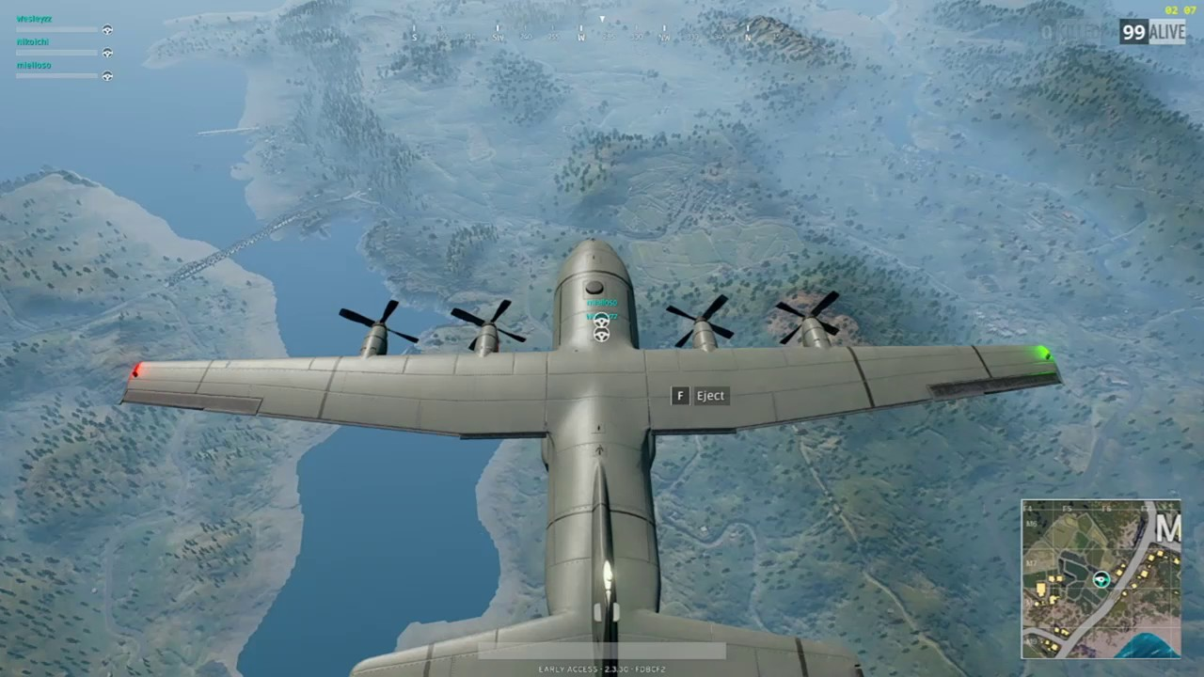
PUBG Flight Drop

Slide 3
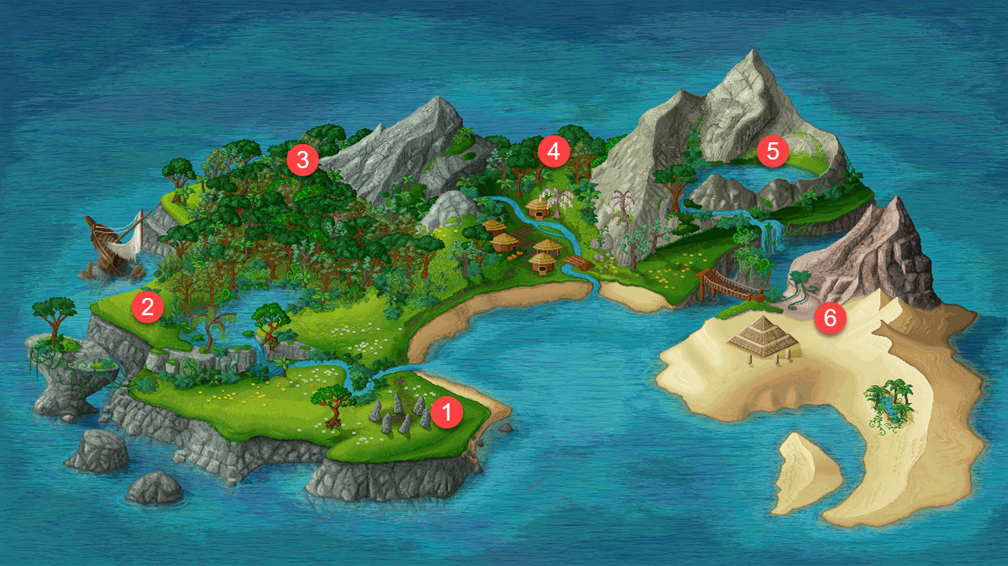
Tech-Know School Island
EDA and Visualization
ML Algorithms
PAL and APL
Python Intro and Math Foundation
Intro to ML and Data Science
SAP Leonardo

Slide 4
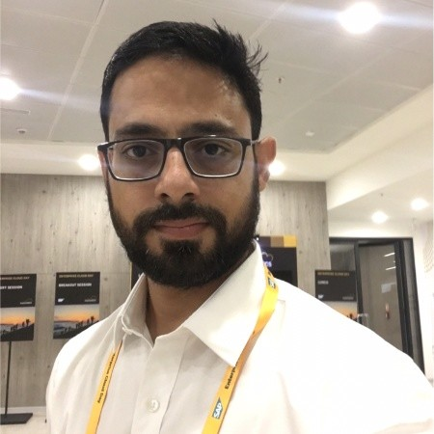

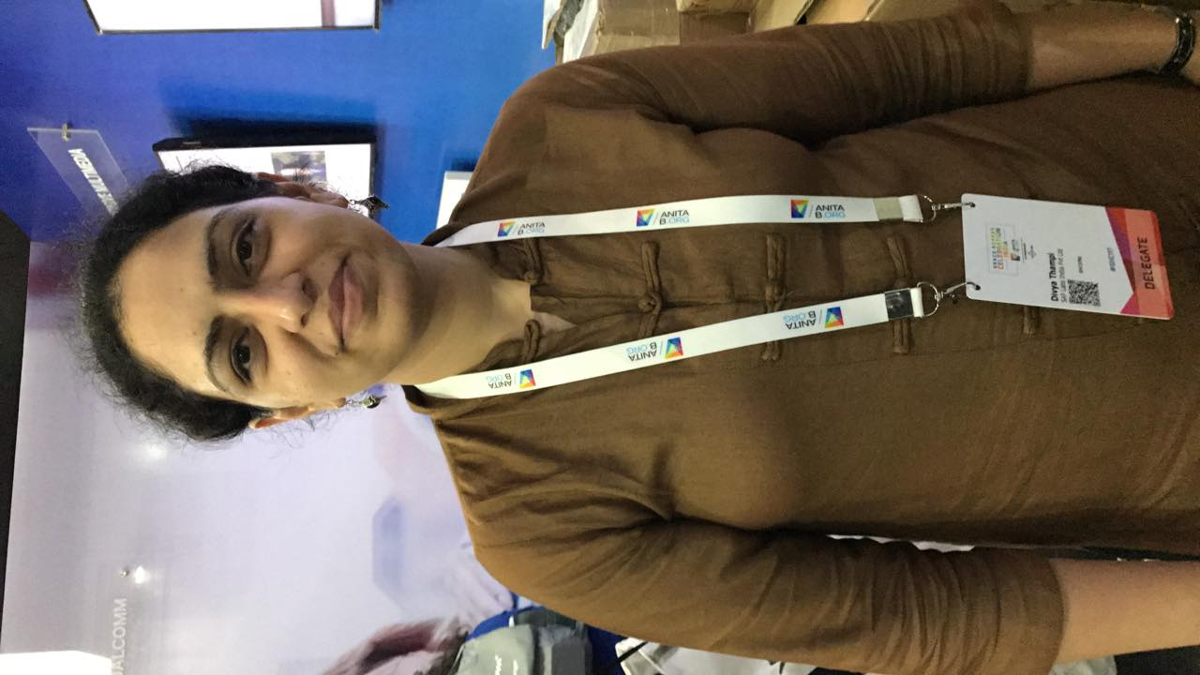
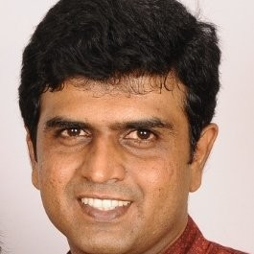
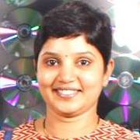
Tech-Know School Core Team
Ankush Mane
Bridge Lead, CPO and Dev Manager GS
Abhik Shome
Dev Manager: Industry Cloud and CD
V Deepa
Dev Manager: S4 Procure
C Praveen
Dev Manager: ICD FND & APPS FMS
Pinki Pachisia
Dev Manager: S4 Produce

Slide 5
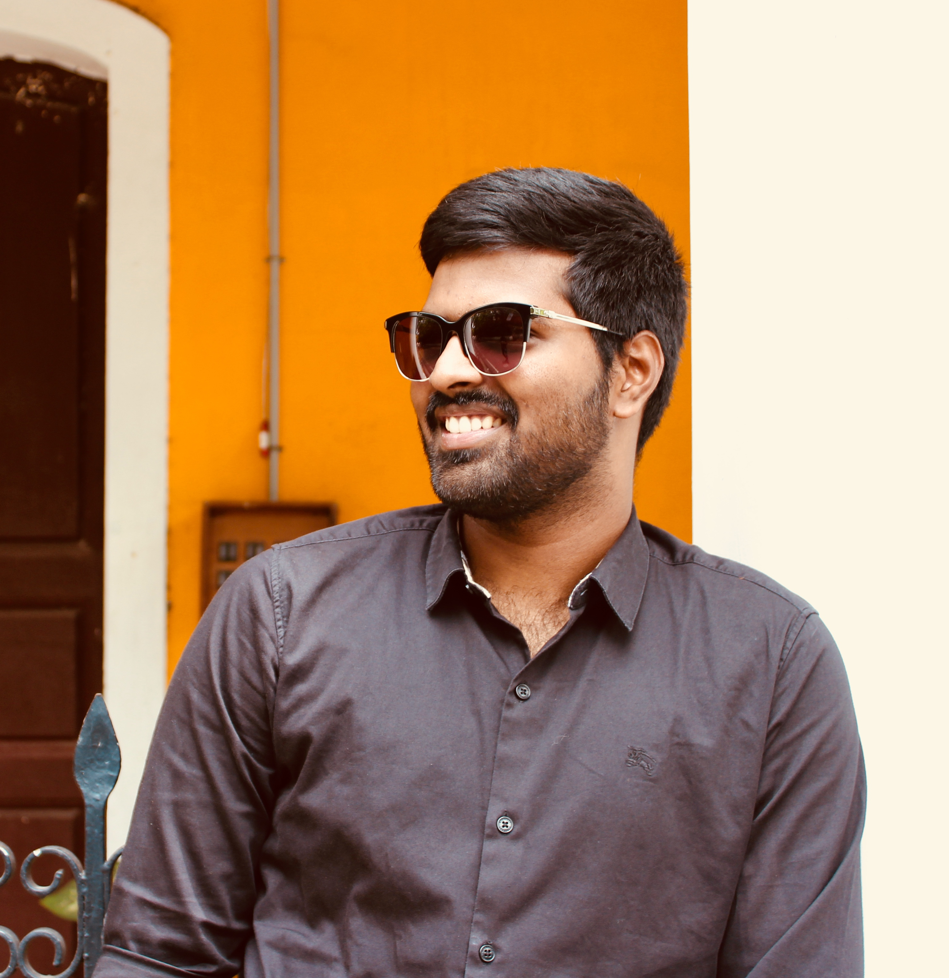
Technical Evangelists
Raja Ram Kankipati
Team: ICD Oil & Gas and Mill Products
Weapons:
Python, Math, EDA, Visualization, Machine learning
Why as a ML Trainer:
Sharing is caring, I always believed in the philosophy. My interest in teaching made me to choose this platform.
I am very lucky to be part of the team. Learning never ends and now it is going to start again ☺.

Slide 6
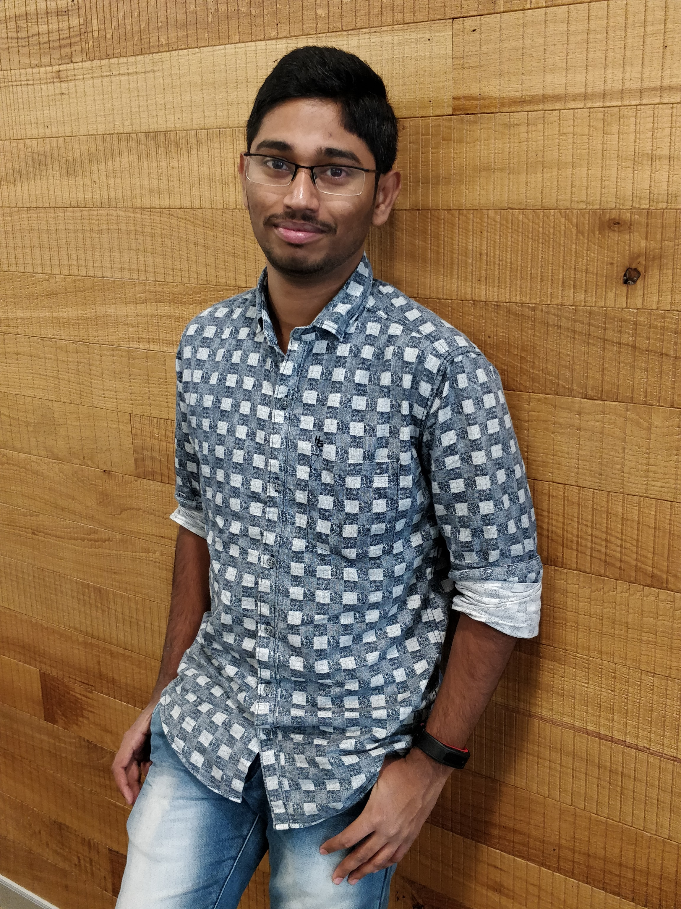
Technical Evangelists
Sundeep Gullapudi
Team: Digital Manufacturing S4 Produce
Weapons:
Python and Deep learning
Why as a ML Trainer:
Deep learning enthusiast loves to share knowledge

Slide 7
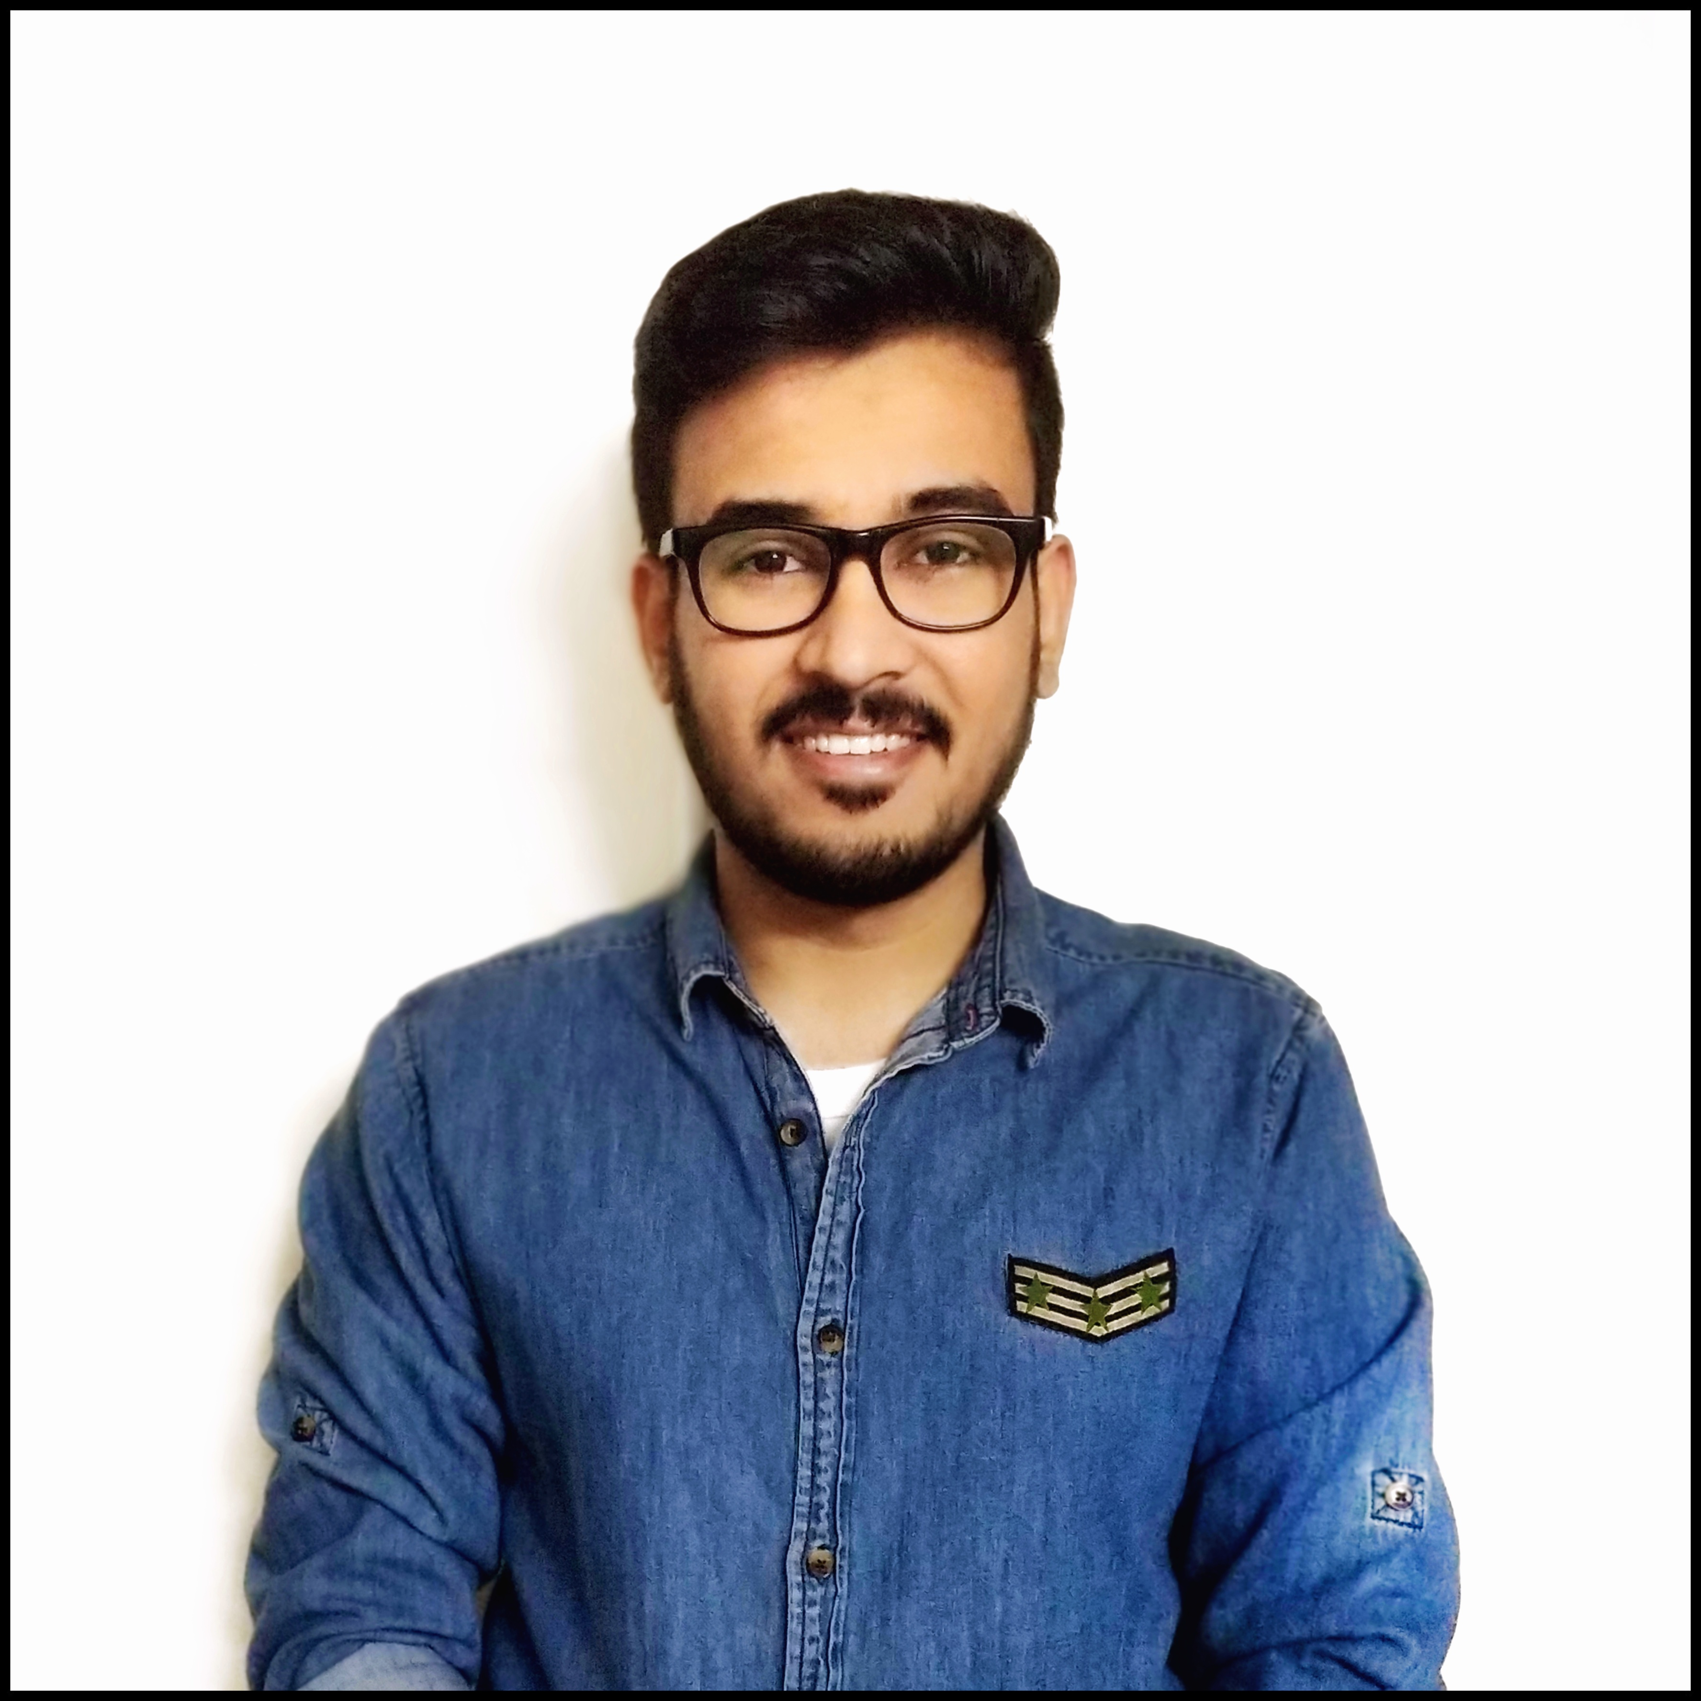
Technical Evangelists
Joshi Harshit
Team: Industry Cloud and CD
Weapons:
Predictive Analytics , SAP HANA PAL/APL, Data Science
Why as a ML Trainer:
We have heard ‘Data is the oil’ but what interests me more are the hidden insights that we can derive out of data by using Machine Learning and other techniques which are typically imperceptible.

Slide 8

Technical Evangelists
Poshak Jaiswal
Team: Digital Manufacturing S4 Produce
Weapons:
SAP Leonardo, Python
Why as a ML Trainer: Always fascinated by new problems to be solved.

Slide 9
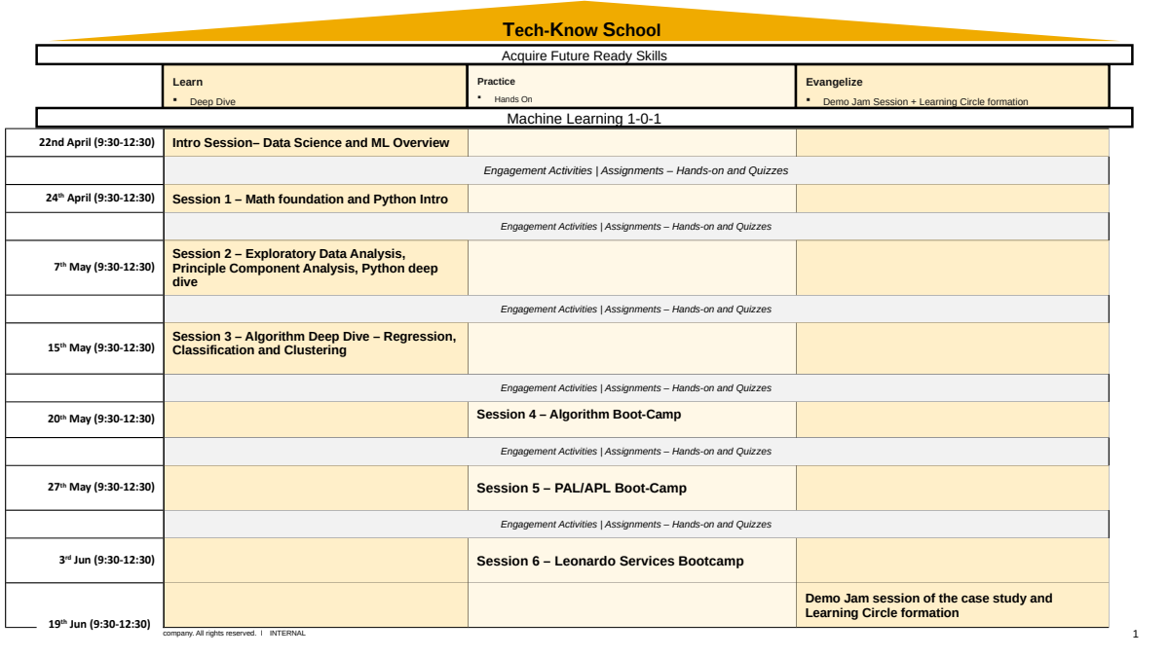

Slide 10
Thank you.
Partner logo

